Slide 1
SCULPTURE
AND ITS FORMS

Slide 2
What is Sculpture?
Sculpture is a branch of visual arts.
Operates in 3-dimensions and 2-dimensions as well.

Slide 3
Forms of Sculpture
Natural Forms (Stones, trees etc)
Man made
Functional (Fountains, Architecture, Jewellary, pottery, furniture, toys)
Non Functional ( for visual pleasure)

Slide 4
Process
Additive (Modeling) / Construction
Subtractive (carving or carved out)
Molding & Casting

Slide 5
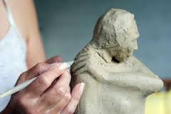
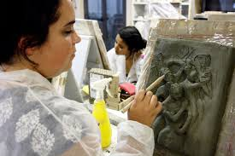
Additive & Subtractive methods

Slide 6
Materials
The materials used in sculpture are diverse, changing throughout history.
Paper Mache
Mix Media
Fabrics, threads, Foams
Wire Sculpture
Soap Sculpture
Terracotta Sculpture
Stone Sculpture
Marble Sculpture
Wood Sculpture
Bronze Sculpture
Fiber Glass
Glass sculpture
Installations

Slide 7
Molding
A mold is the negative or hollow cavity produced around a sculpted piece for use in creating multiples of that piece. It can be made of plaster or silicon.
Casting
A cast is the positive or reproduction of the original piece of sculpture created by pouring casting material into a pre-formed mold. Material used for casting can be plaster or clay.

Slide 8
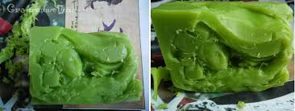
Wire & Soap sculptures

Slide 9
Sculpture Tools

Slide 10
TYPES OF SCULPTURE
1. SCULPTURE IN ROUND
2. SCULPTURE IN RELIEF
Bas or Low Relief
High Relief
Sunken Relief

Slide 11
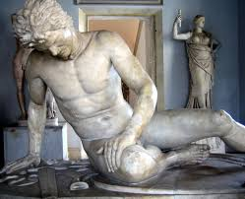
1. Sculpture in Round
We can walk around
a sculpture in round, it is
freestanding
such as statues.

Slide 12
PAKISTANI HANDICRAFTS DOLLS

Slide 15
PRIEST KING from Indus Valley

Slide 16
Venus of Willendorf from Paleolithic Age

Slide 17
Rodin’s The Thinker

Slide 18
Parthenon Sculpture

Slide 19
Moses by Michelangelo

Slide 20
Henry Moore was famous for his 'Reclining Figure'

Slide 21
Terracotta Figurines

Slide 22
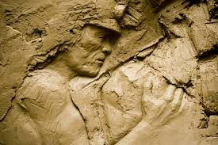
2. Sculpture in Relief
A relief is a sculptural technique. The term relief is from Latin verb, to rise. A relief is only partly carved out of any material. It is always attached to its surface.

Slide 23
Types of Relief
Bas Relief (Low Relief)
Alto Relief (High Relied)
Sunken Relief (Intaglio Relief)

Slide 24
Bas (Low) Relief (Type 1)
A French term from the Italian basso-relievo ("low relief"), or bas relief is a sculpture technique in which figures and/or other design elements are just barely more prominent than the (overall flat) background.

Slide 25
Bas-Relief From the Entablature, Jerusalem Chamber, Westminster Abbey

Slide 29
Indus valley terracotta flask

Slide 30
Floral rosette

Slide 31
Mahabalipuram (India) 2nd largest bas relief worldwide

Slide 32
Indus seal

Slide 33
Indus seal

Slide 34
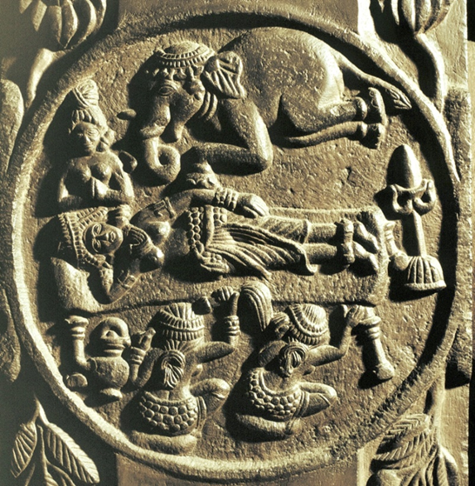
Dream of Queen Maya

Slide 36
High Relief (Type 2)
A sculptural relief in which forms extend out from the background to at least half their depth, also called alto relieve.

Slide 37
A sandstone high relief sculpture of Ganesha India, 10th century

Slide 38
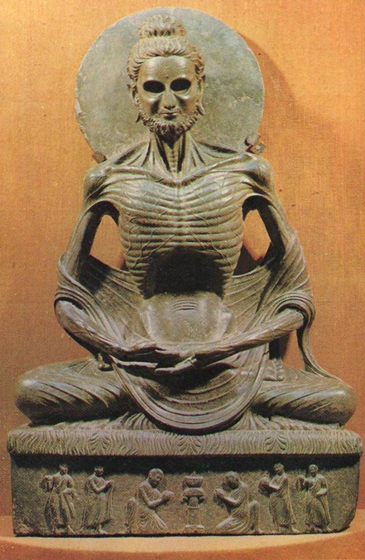
Fasting Buddha

Slide 39
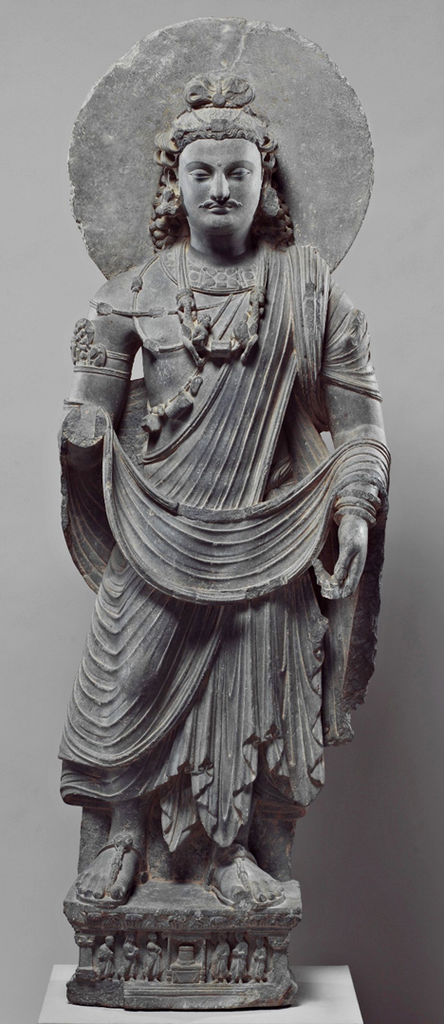
Standing Bodhisattva

Slide 40
This frieze depicts Romans leading off bound Persians after defeating them in battle.

Slide 41
Hunter or Warrior (Gandhara)

Slide 42
Sunk Relief (Type 3)
A carving or other type of relief that does not project beyond the flat surface on which it is cut; also called carvo-relievo.
The technique is most successful with strong sunlight to emphasize the outlines and forms by shadow, as no attempt was made to soften the edge of the sunk area.

Slide 43
Sunk Relief

Slide 45
Architectural sculpture is attached to buildings
Small-scale sculpture decorates other objects, as in much pottery, metalwork and Jewellary.

Slide 46
Porch of Maidens, Greece

Slide 47
Architectural sculpture, Mortimer Street, London

Slide 48
Yaksha Yakshis, Sculpture at Temple Forty five, 45 at Sanchi Stupa, Madhya Pradesh, India

Slide 50
Sculptural Jewellary

Slide 55
Sculptural Weapons

Slide 56
A Mughal jade-hilted dagger, India, 18th Century

Slide 57
Functional Sculpture

Slide 58
Hand Lamp

Slide 59
Decorative Mughal Hukka

Slide 60
Sculptural Fountains
Rome

Slide 63
White Marble Fountain Tray

Slide 66
Non Functional Sculptures

Slide 71
Made by Ruby Chisti

Slide 72
Unique Art from old car parts by James Corbett

Slide 80
Mix Media

Slide 81
Natural Forms (Poppy Pods)

Slide 84
Installations

Slide 85
Installation Art Chairs

Slide 90
Sculpture in Round, installation

